Slide 1
Stillness Detector Workshop
Create Installations That Reward Serenity

Slide 2
A Quick Look Back: Wabi-Sabi Electronics
Wabi-sabi finds beauty in imperfection, impermanence, and quiet. Our devices aim to nourish the soul rather than demand attention.
Technology should feel calm, natural, and humane — not noisy or demanding
We design for humane intent rather than clicks, likes and alerts
Experiences we create are meant to be imperfect and impermanent, but also calming and welcoming
Today: a device that senses stillness and rewards it with something expressive

Slide 3
What Is Stillness Detection?
Stillness detection senses when a person, typically a viewer of an interactive installation, is present and not moving, reporting their state so your project can react.
A starting point, not a finished product — this is a prototype
Recommend using it as-is to get going, then modify or replace it as your project grows
It distinguishes three states: presence, absence, and stillness
Output is simple enough to drive almost anything: lights, sound, motors, bubble machines, projection mapping, etc.

Slide 4
Your Kit
Stillness Detector
The prototype device — senses presence with stillness and reports the current state.
USB Micro-B Cable
Power and serial data over a single connection.
USB Power Supply
Run the device standalone, no computer required.

Slide 5
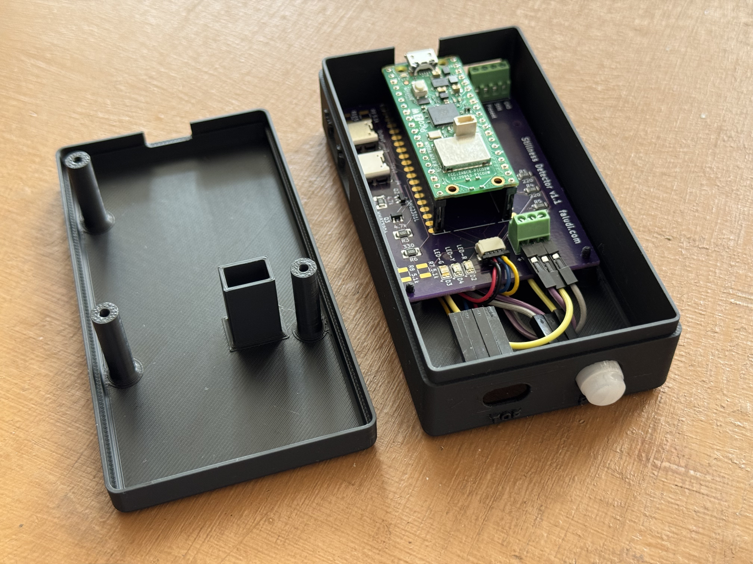
Stillness Detector

Slide 6
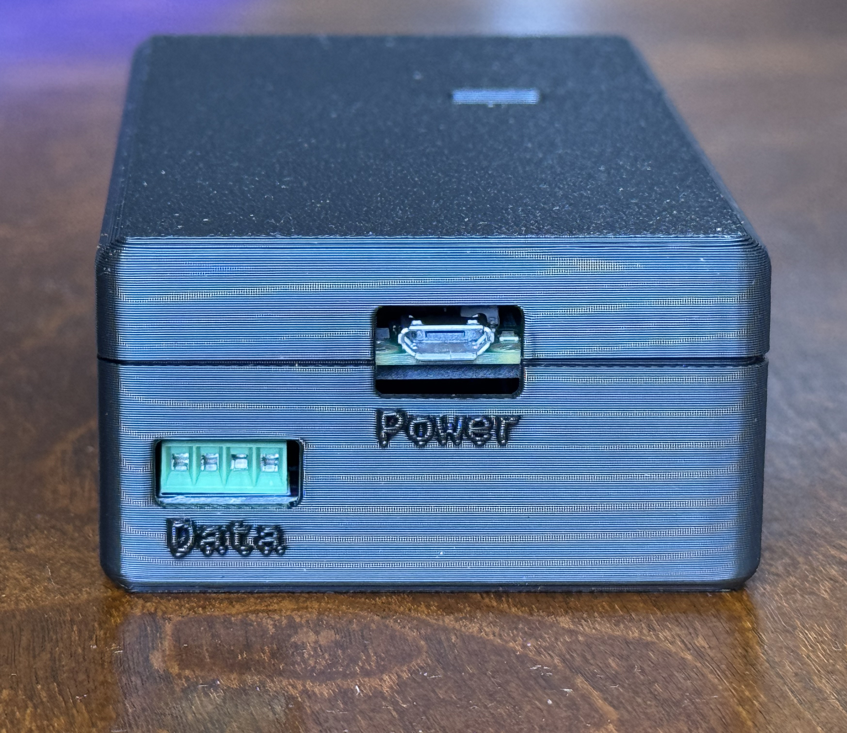
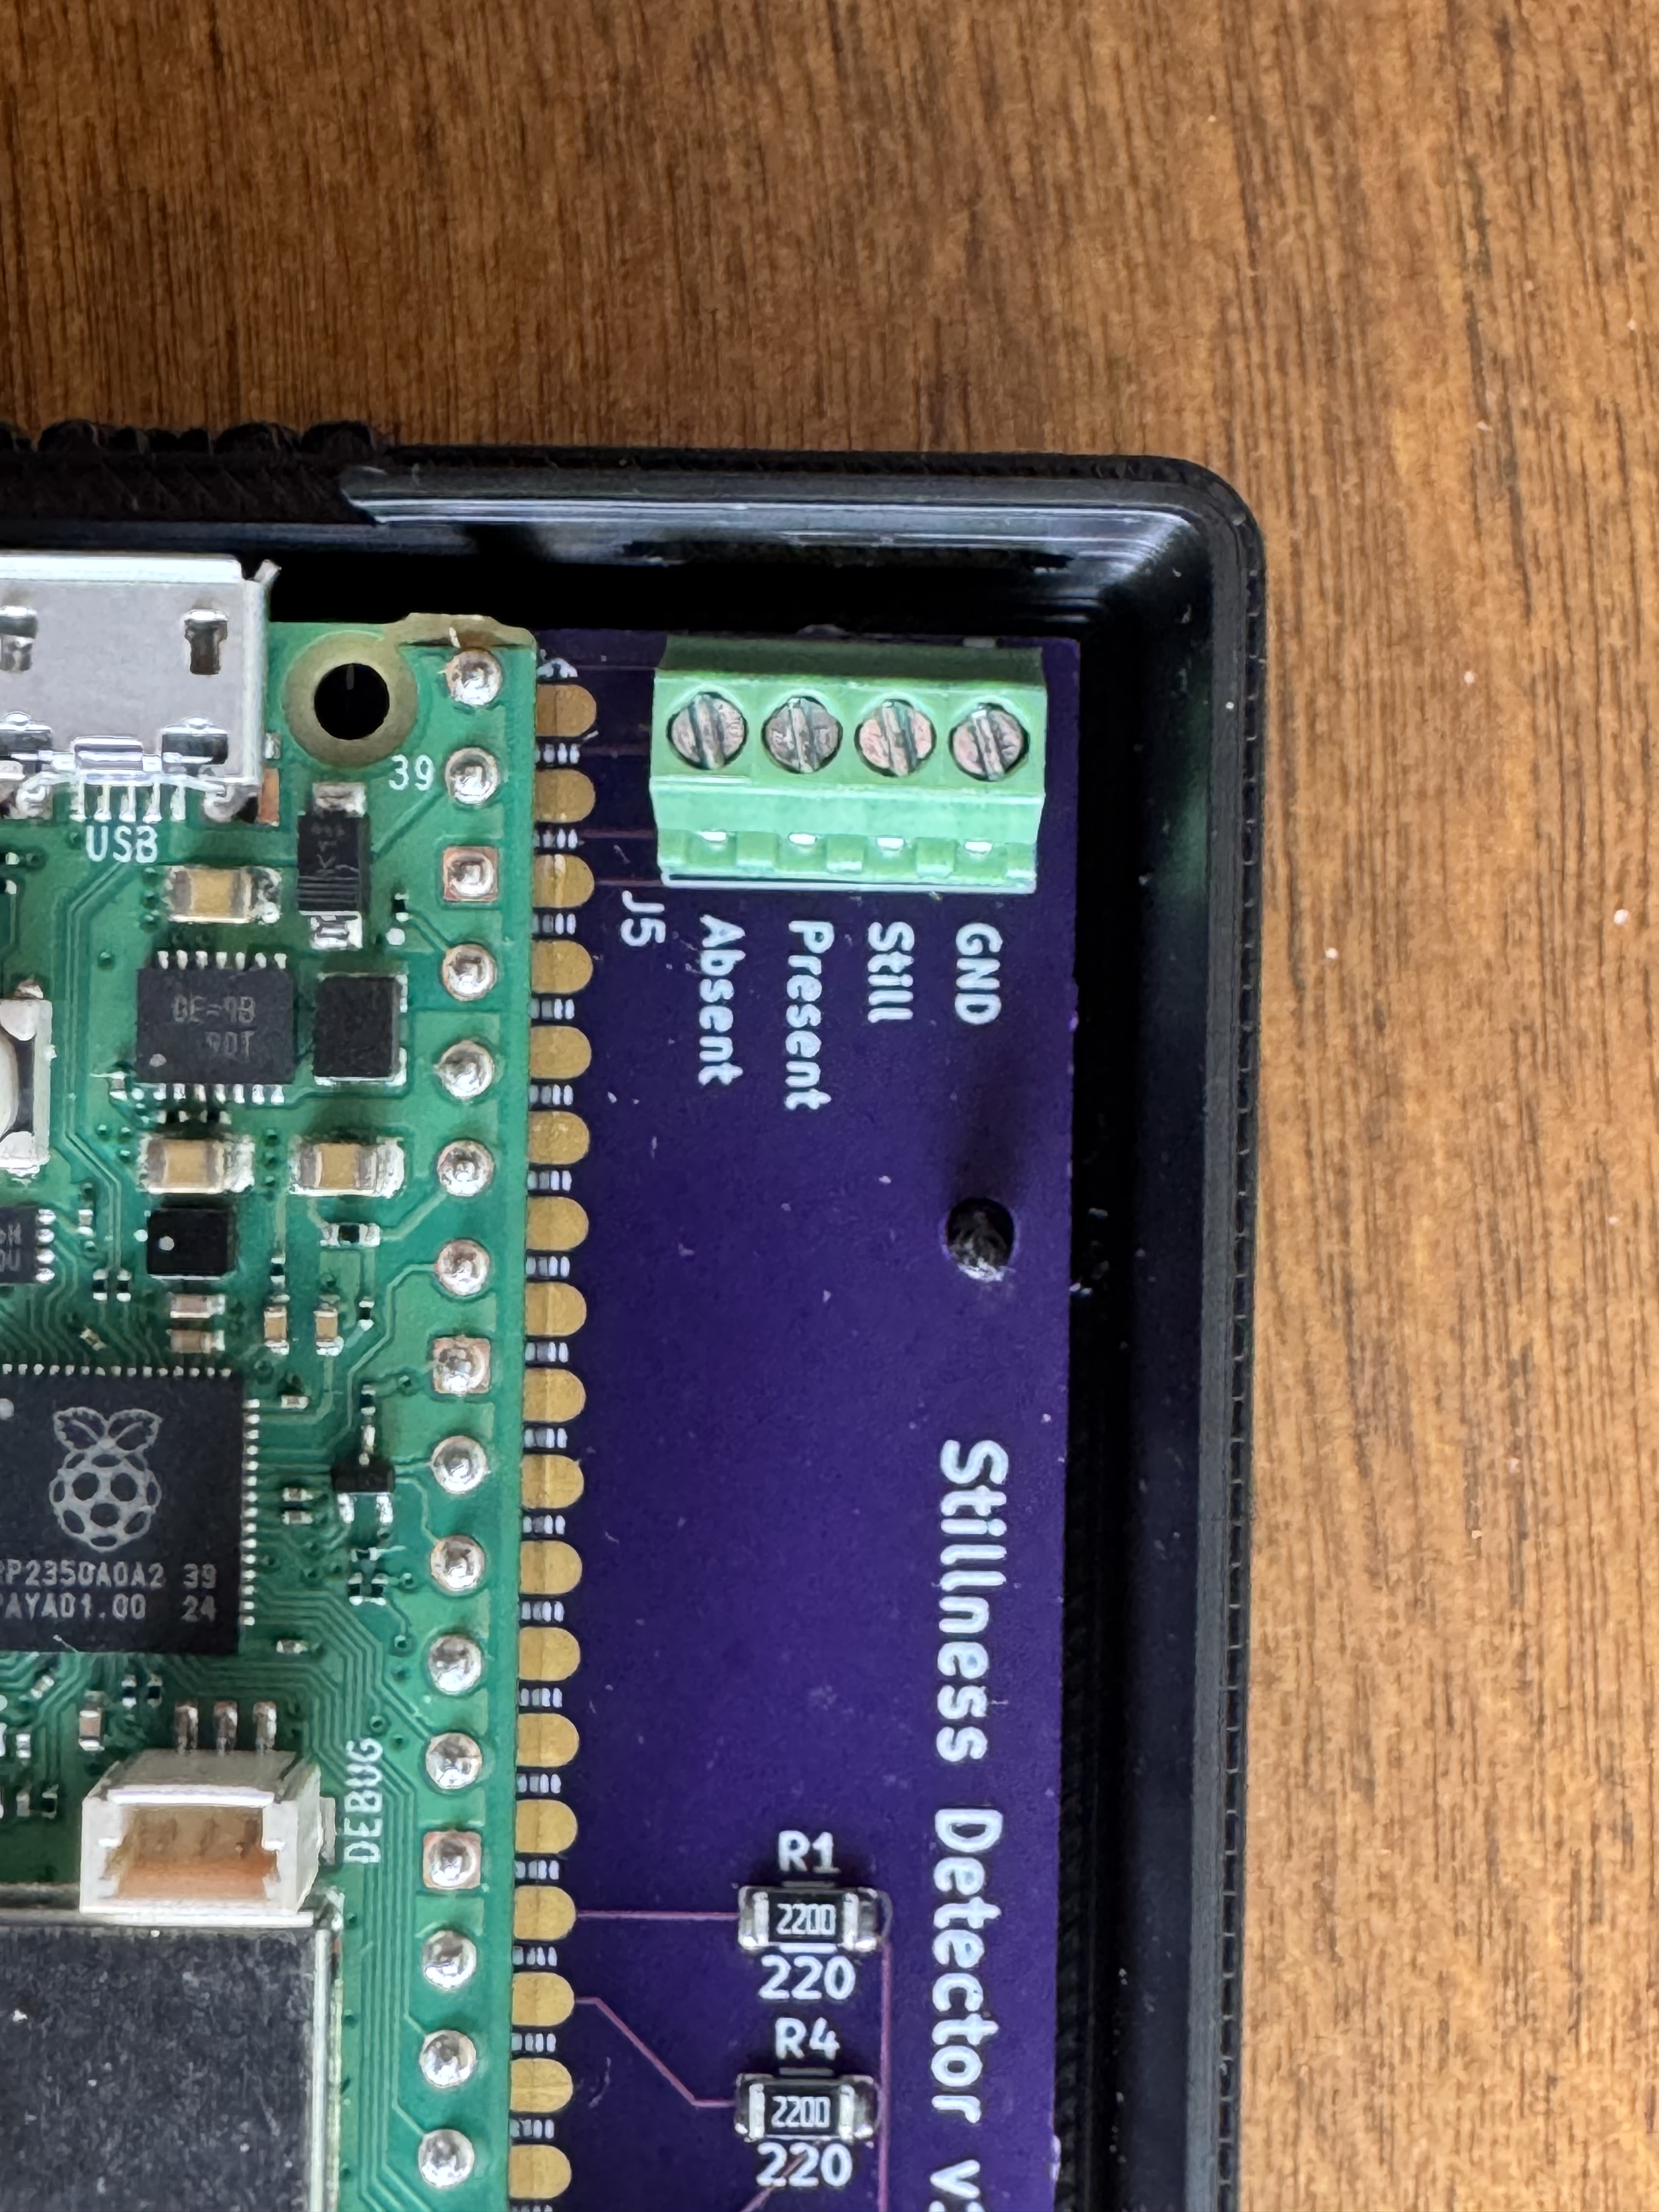
Stillness Detector – Power & Data

Slide 7
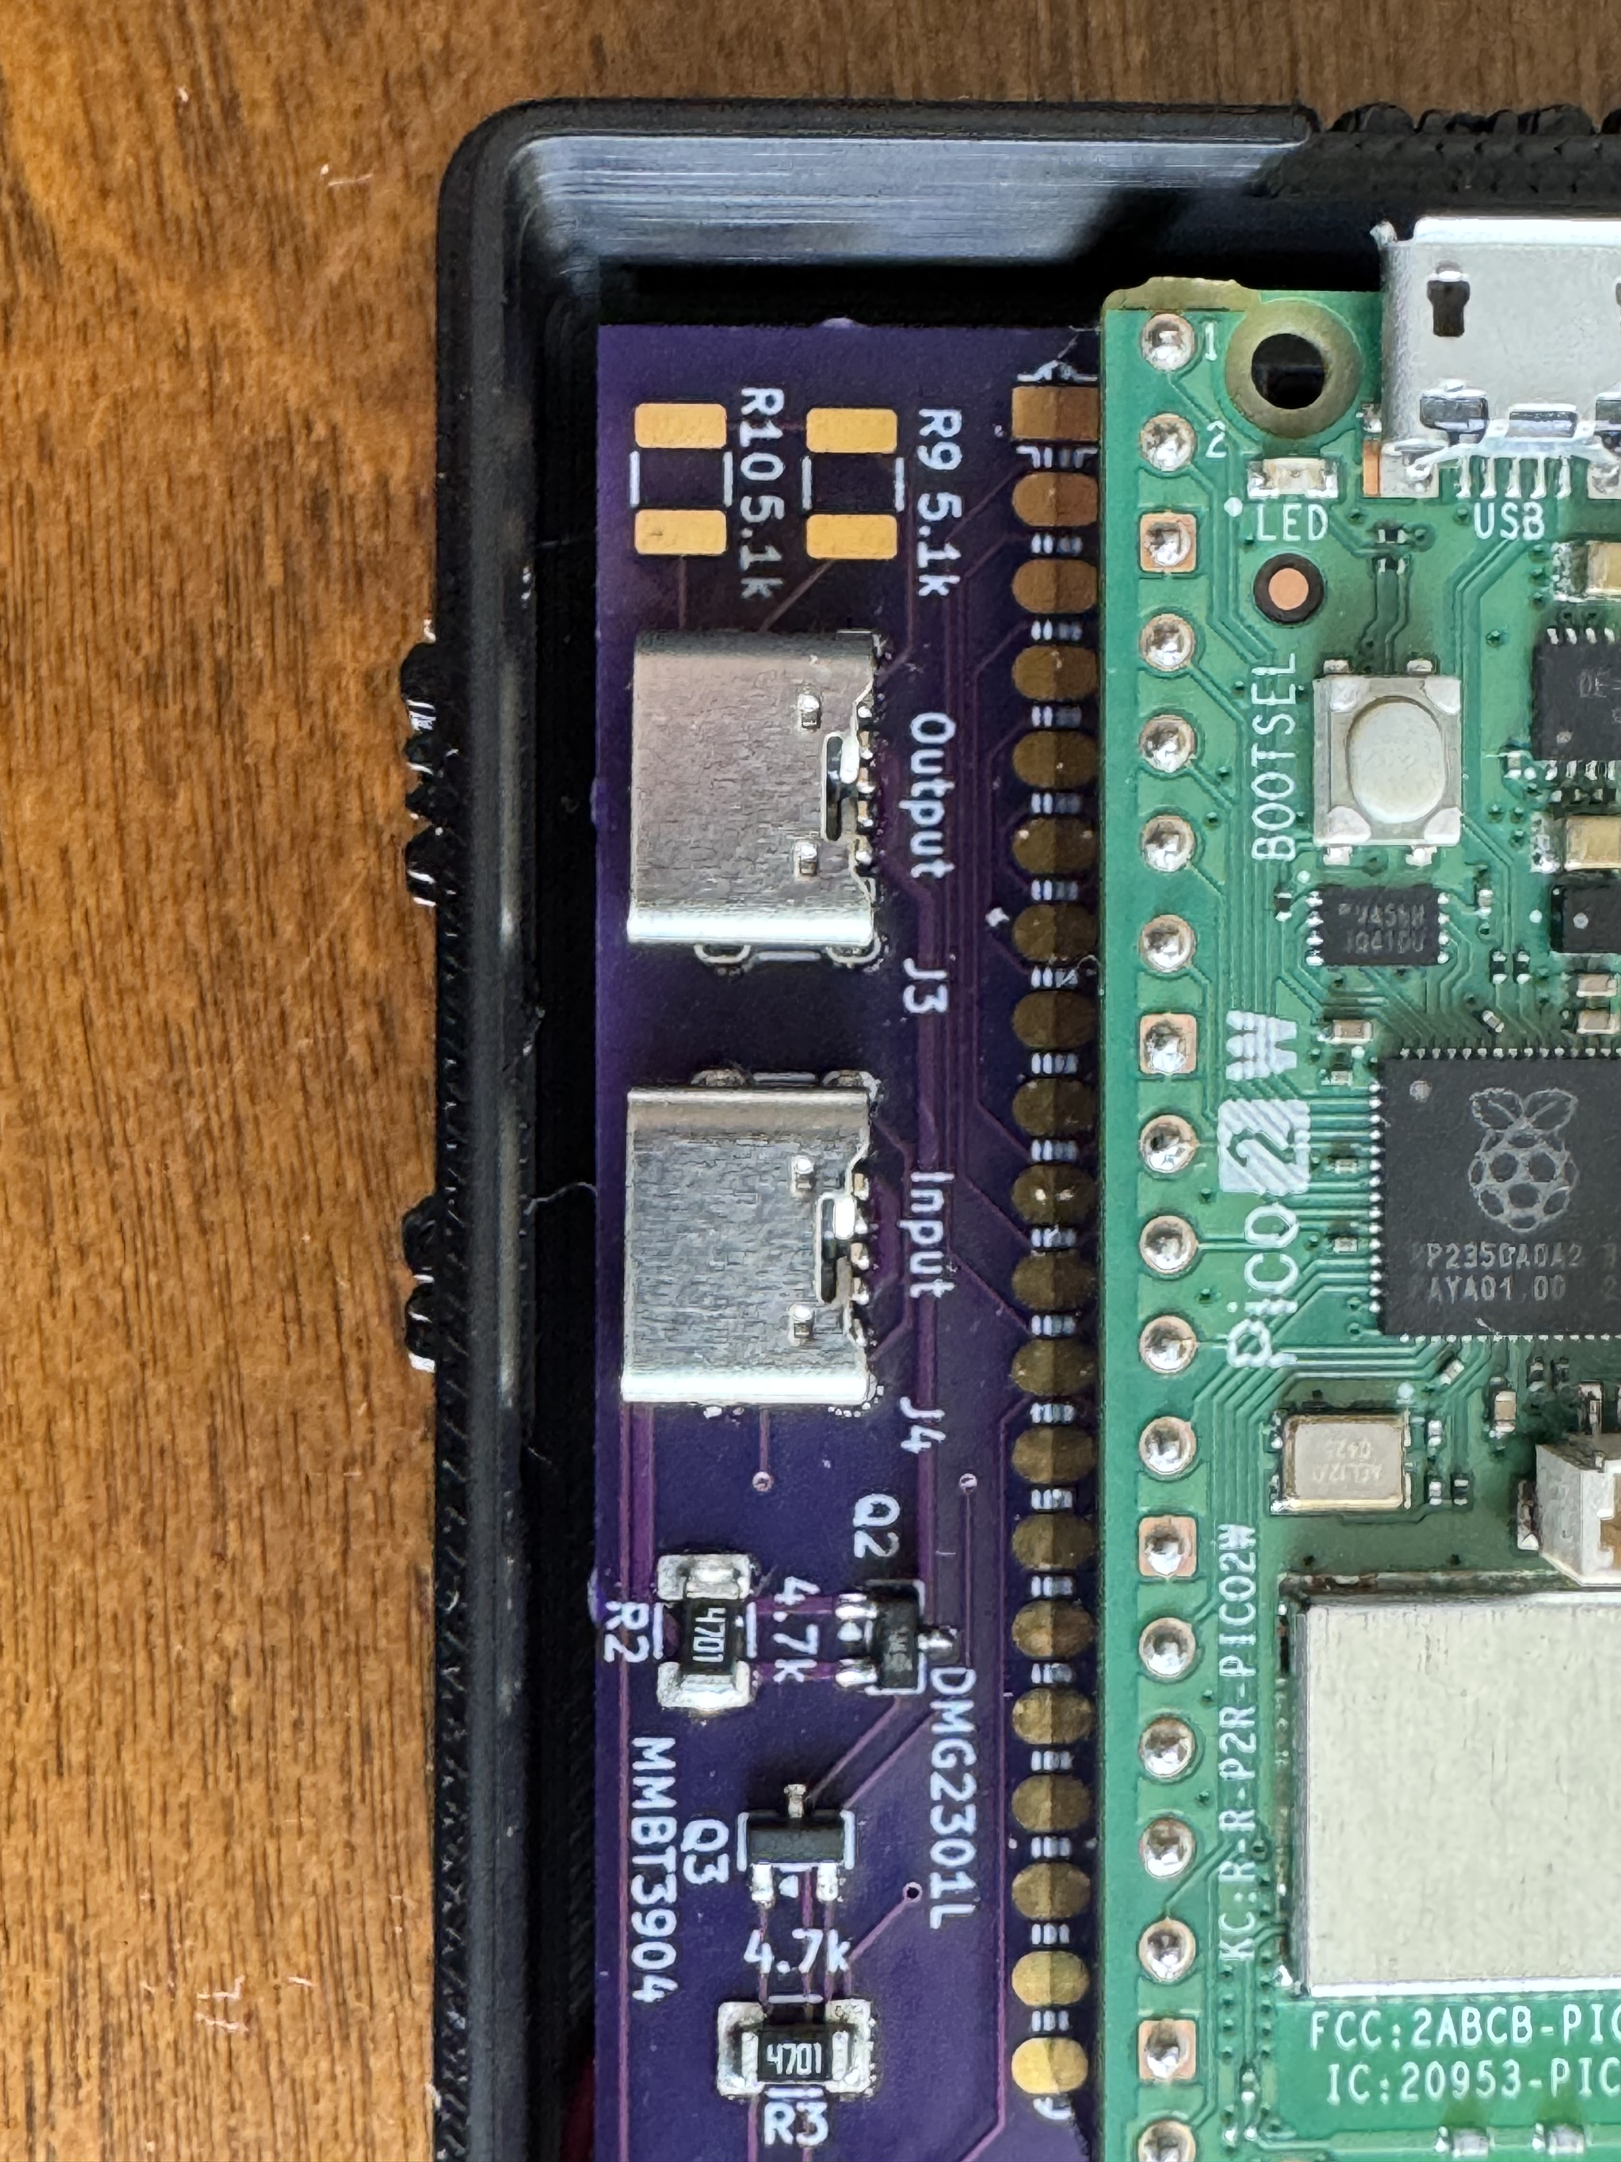
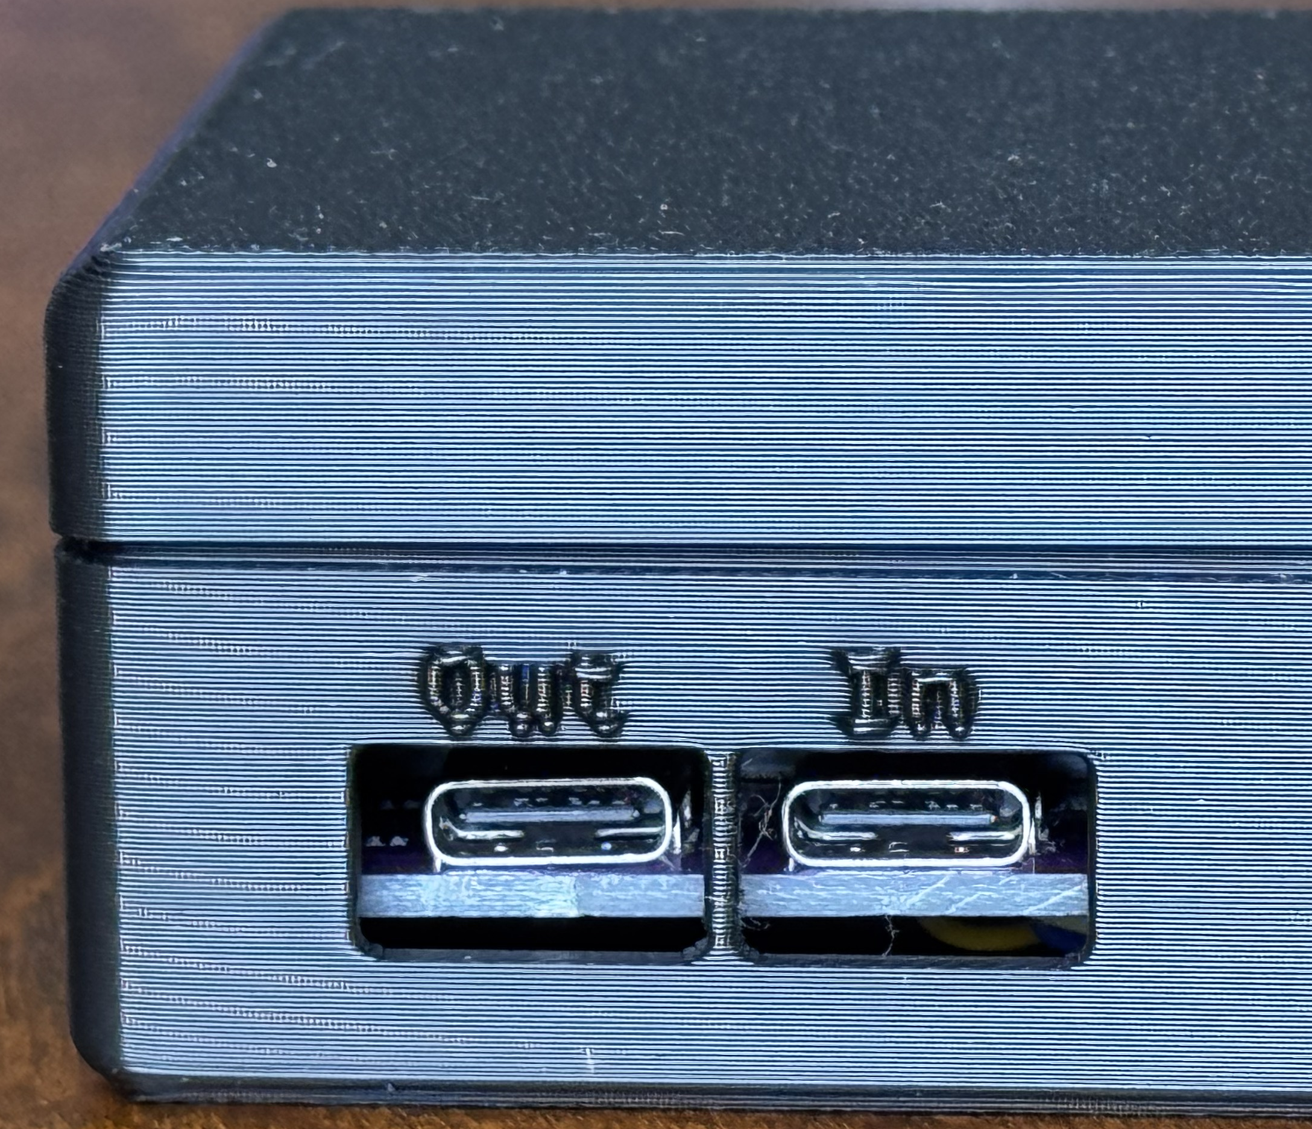
Stillness Detector – USB-C Power Switching

Slide 8
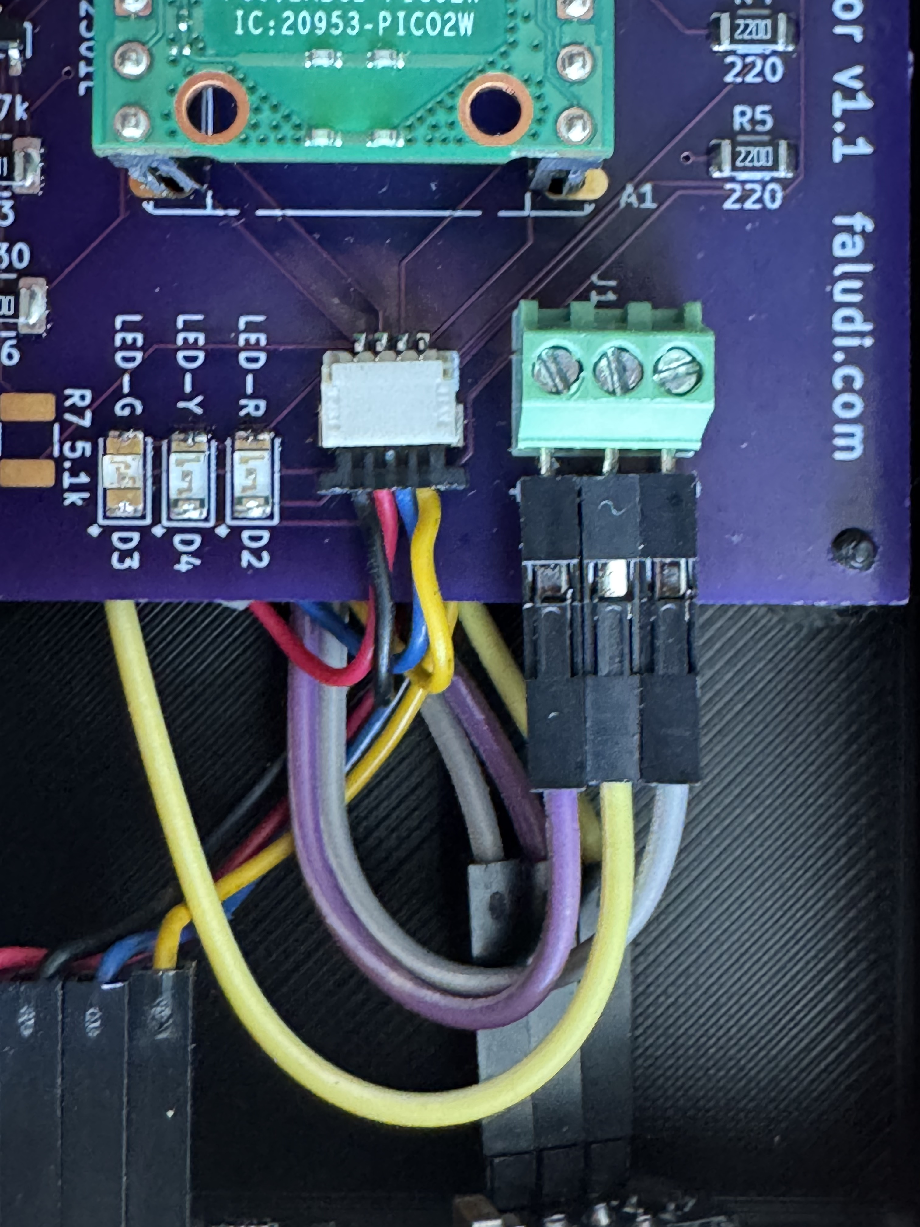
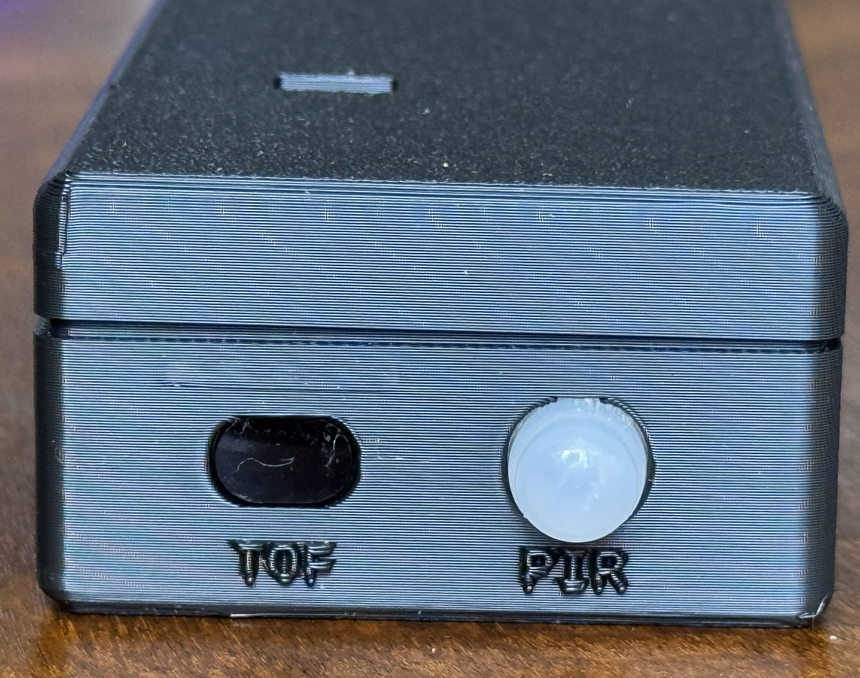
Stillness Detector – Sensors & LEDs

Slide 9
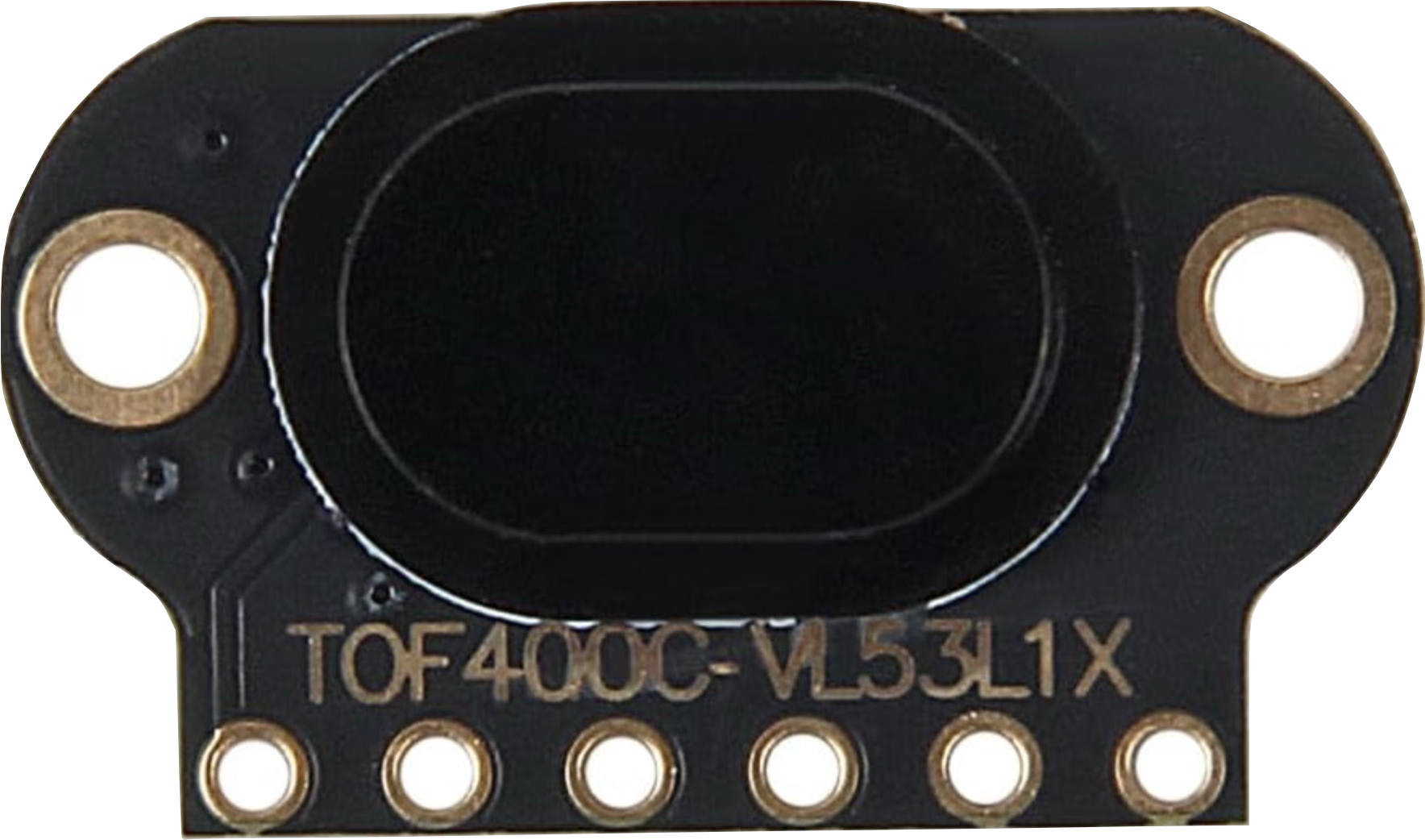
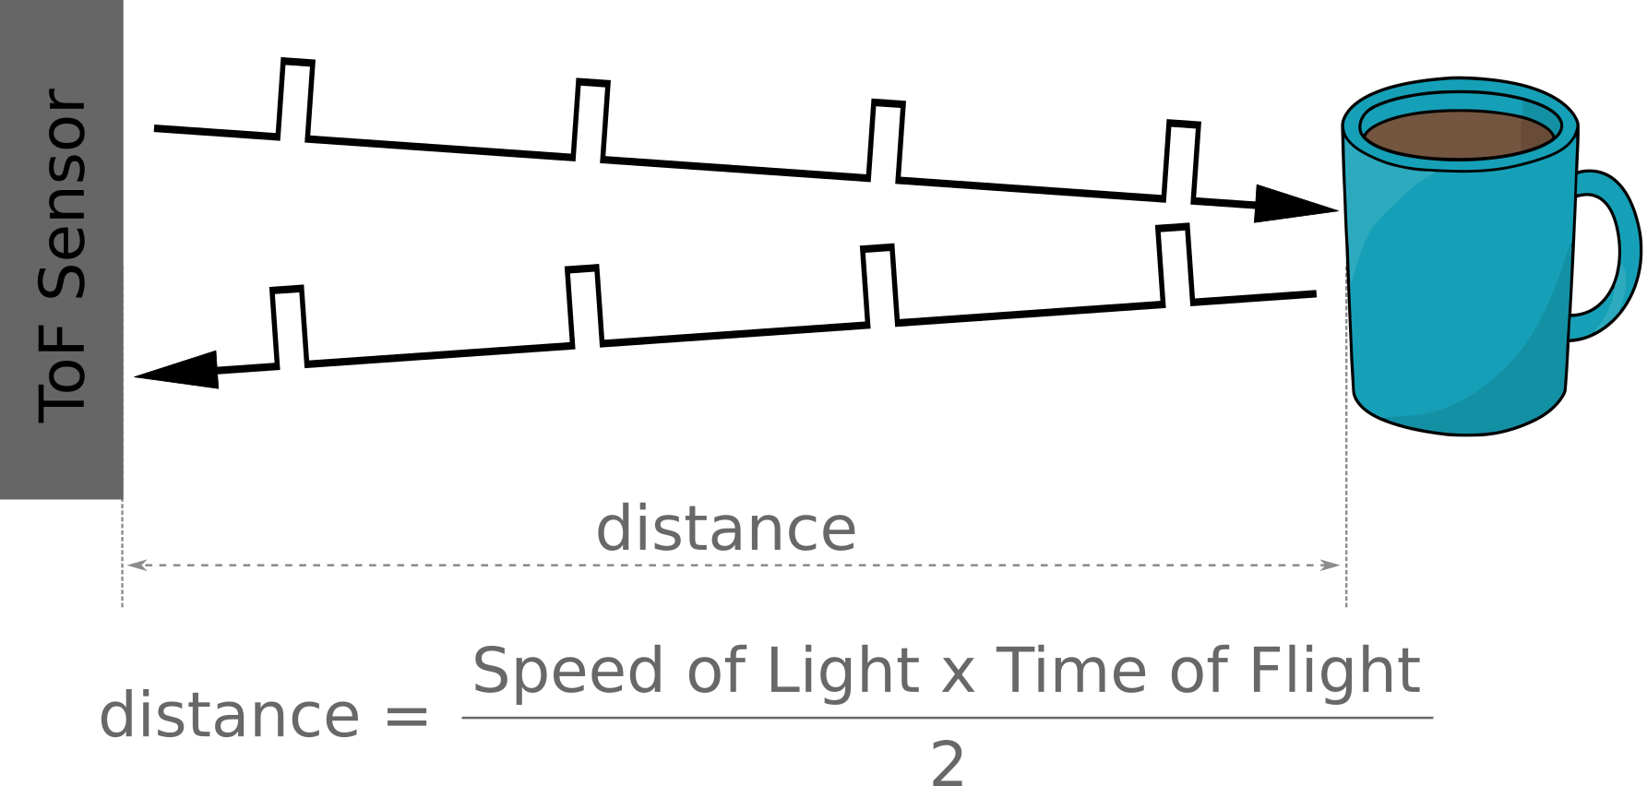
Time-of-flight Sensor - TOF

Slide 10
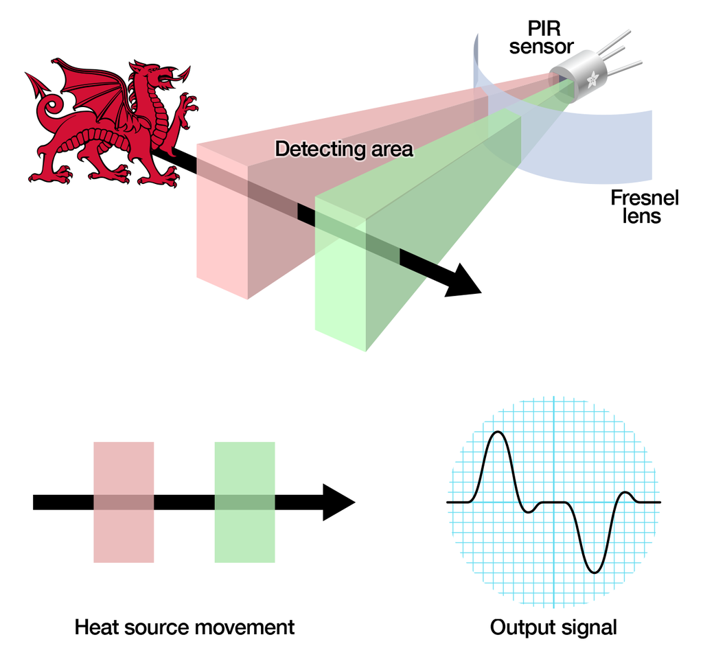
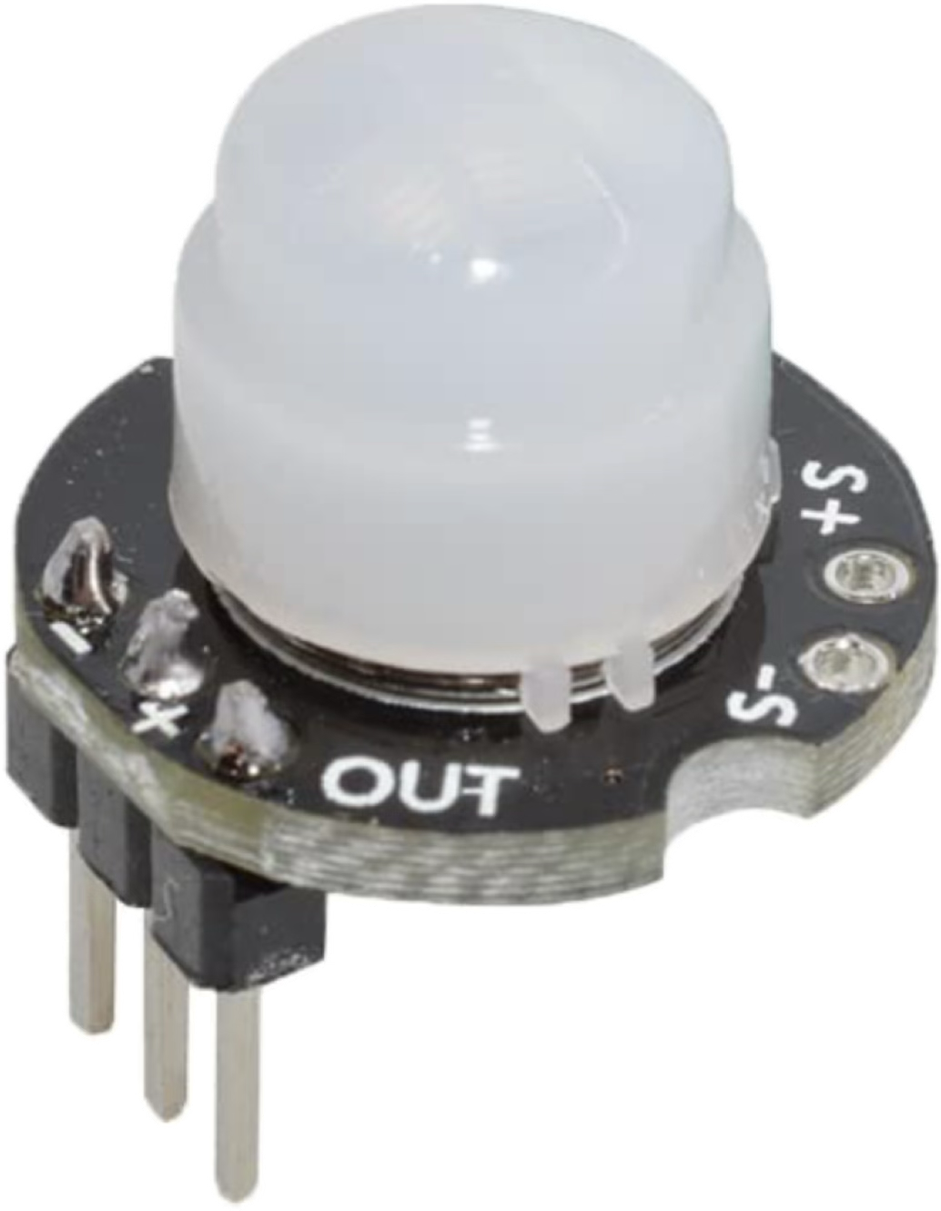
Passive Infrared Sensor - PIR

Slide 11
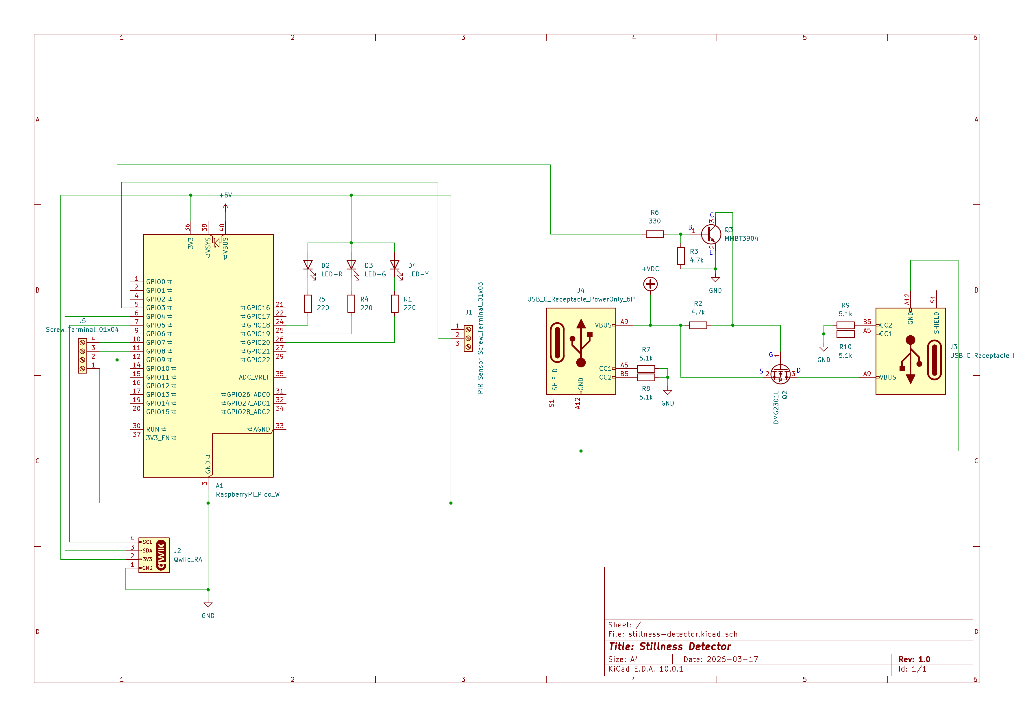
Schematic

Slide 12
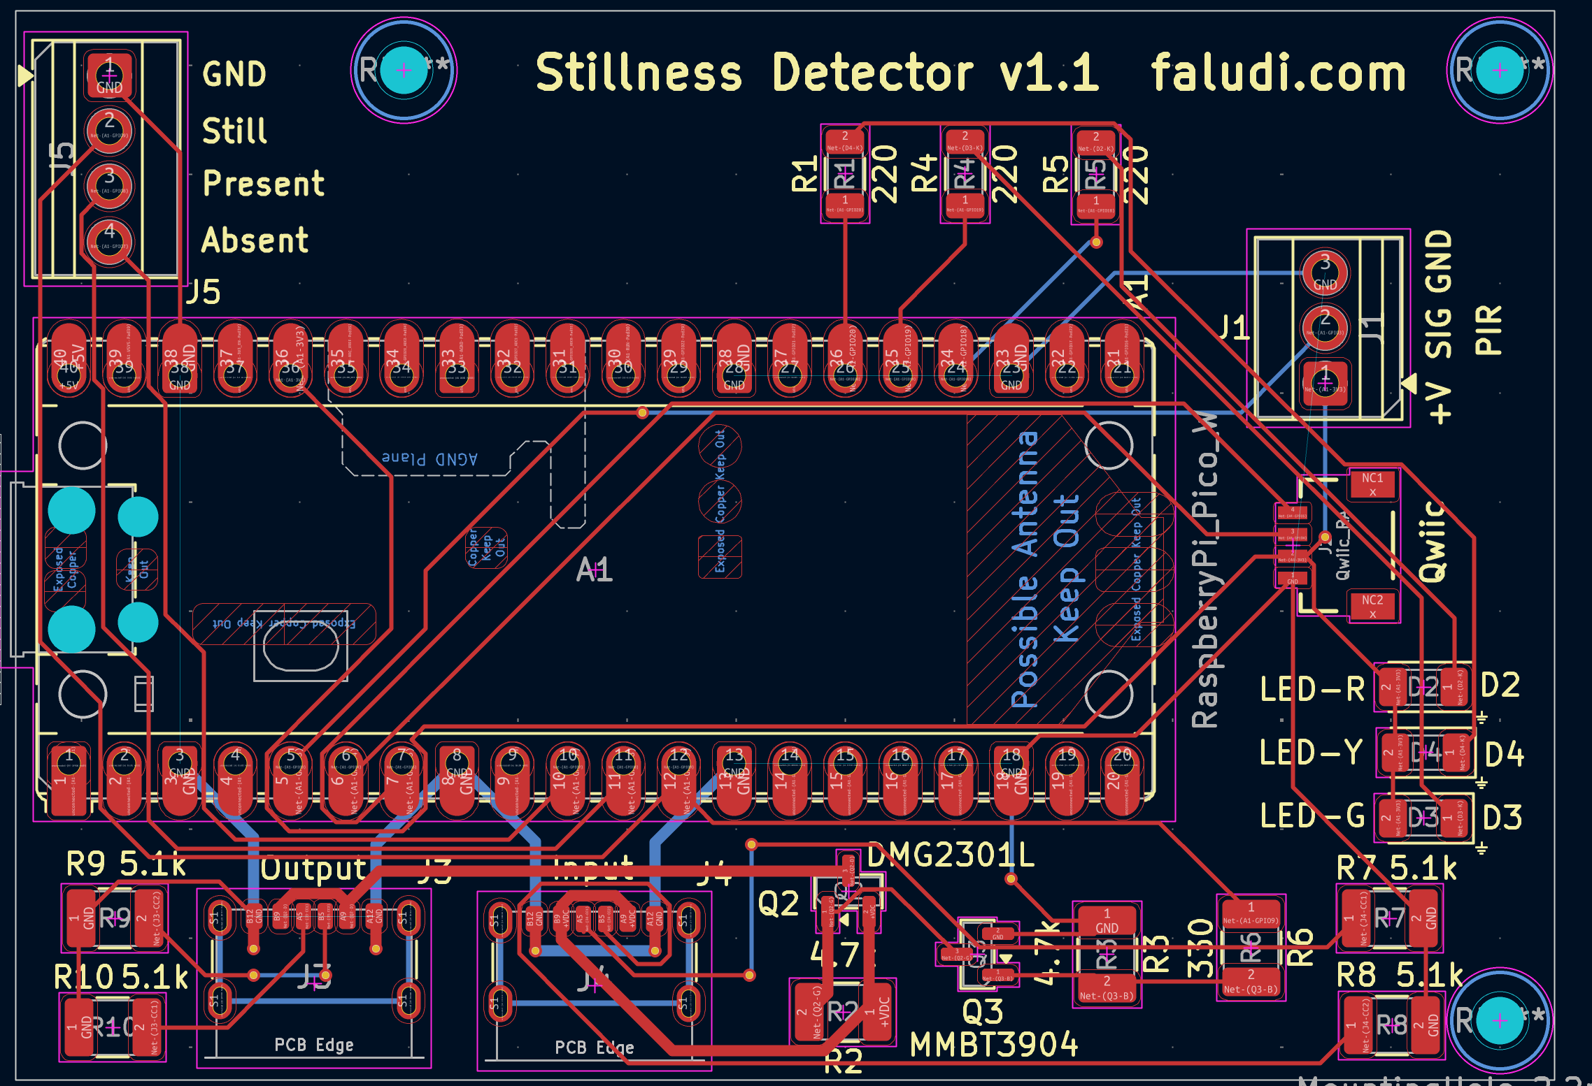
PCB

Slide 13
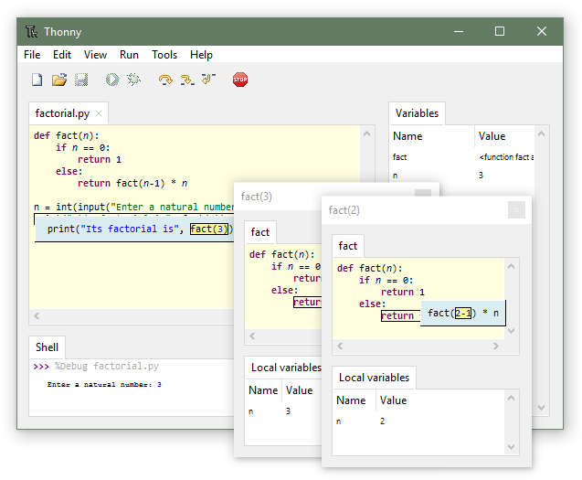
Thonny
Python IDE for beginners
http://thonny.org

Slide 14
Settings & What They Do
Parameter | Effect | Unit | Typical Range
SETTLING_DELAY | Time before stillness is triggered after presence detected | seconds | 2–10
DAMPING_INTERVAL | Minimum gap between motion events to filter noise | seconds | 3–20
ALLOWABLE_DISTANCE_CHANGE | Max forward/backward sway before stillness lost | mm | 100–1000
MIN_DISTANCE | Nearest detection range (person too close = not detected) | mm | 200–500
MAX_DISTANCE | Farthest detection range (person too far = not detected) | mm | 1000–3000
PIR_RESET_TIME | Duration of a PIR trigger (from data sheet or testing) | seconds | 1-4

Slide 15
Mode Presets
Mode | Settling Delay (s) | Damping Interval (s) | Allowable Distance Change (mm)
relaxed | 3 | 3 | 1000
normal | 5 | 7 | 300
strict | 10 | 20 | 200
custom | custom | custom | custom

Slide 16
Other Methods
Husky Lens
AI vision camera — recognize faces, objects, and motion on-device. More expensive and finicky. Can follow multiple people and their attention.
Human Presence Detector
Millimeter wave detection radar sensing for people in a space, including when they are moving or motionless. Inexpensive but very finicky. Has the potential to see through walls.
Video Processing
Analyze a camera feed for movement and change over time. Higher learning curve as you need to build your own AI-enabled video detection. Completely customizable.
Floor Mat & Other Triggers
Pressure mats, switches, and custom inputs to suit your piece. Wise makers know that often a simple switch is the best solution.

Slide 17
Live Demonstration
Let's see the stillness detector in action.

Slide 18
Demo 1: Lights & USB
Watch the Lights
On-board LEDs show the live state at a glance
Presence, absence, and stillness each have a signal
The fastest way to confirm the device is working
Plug In Over USB
One cable for power and data
Appears as a serial device on your computer
Stillness events stream out as you sit quietly

Slide 19
Demo 2: USB-C Power Control
Wire Up
Power supply or USB battery plugged into “In” port
Device itself plugged into “Out” port
Make sure battery isn’t the type that falls asleep!
Run
During absence and presence power is switched off
When stillness is detected, your project receives power
No coding or electronics development required

Slide 20
Demo 3: Data Pins & Microcontroller
Wire to the Data Pins
Presence, absence, and stillness each have a pin
The stillness pin is just data and ground — easy to read
Connect the pins you want to read straight into an Arduino or any microcontroller’s GPIO (digital) inputs.
Hook this into project by reading the input pins to determine the stillness state. HIGH is active.
Watch the Device
Lucky Cat moves randomly during absence
Cat lowers paw during presence
Cat raises paw (and brings) luck for stillness

Slide 21
Demo 4: Editing the Settings File
Tune the device's behavior by editing a plain settings file — no recompiling needed.
Open the settings file from the device
Adjust thresholds, timeouts, and sensitivity
Save, then watch the new behavior take effect
Try making it trigger faster — or hold out for deeper stillness

Slide 22
Ideas for Use
As a USB Controller
Treat stillness events like keystrokes or signals
Drive software, visuals, or sound from a computer
The simplest path — no extra wiring needed
Via the Data Pins
React to presence — someone arrives
React to absence — the space empties
React to stillness — everything goes quiet
Wire directly into motors, lights, or a microcontroller

Slide 23
Creative Time
Quickly design an artwork that reacts to stillness. Pick the path that fits your idea.
1
2
3
EASIEST
Use USB-C Power
Power your project when stillness is detected.
NEXT
Use just the Stillness Pin
Just data and ground — wire it straight into your circuit.
ADVANCED
I2C, SPI, Serial, or WiFi
More power and flexibility — needs to be added to the code.

Slide 24
Bring serenity to your guests
Build with humane intent. Reward for stillness. Welcome and caretake.

